Slide 1
ZERO TRUST MATURITY MODEL| CISA POLICY
.

Slide 2
Table of Contents
Zero Trust Maturity Model Overview
Key objectives of the policy
Impact of ZERO TRUST MATURITY MODEL (ZTMM) on Data Management and Governance
How ZTMM relates to the Broader Federal Data Strategy or Governance Framework
Potential Challenges or Considerations for implementation

Slide 3
Overview of the Zero Trust Maturity Model
Framework Overview: ZTMM serves as a structured approach for integrating Zero Trust Architecture into existing systems.
Core Principles: Essential practices include strict access controls, continuous monitoring, and enforcing least privilege access systematically.
Secure Operations: The framework ensures data integrity and security within networks presumed to be compromised effectively.

Slide 4
Key Objectives of the Policy
Security monitoring
Micro segmentation
Identity and device management
Data protection
Adaptive Security
Continuous verification
Least privilege access

Slide 5





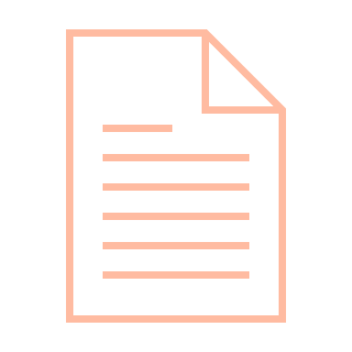

Impact on Data Management and Governance
Risk Mitigation
Compliance Management
Data Integrity Preservation
Enhanced Data Security
Dynamic Access Management
Holistic Data Visibility
Improved Data Governance

Slide 6
Key Impacts on Data Management and Governance
Granular data protection- implements fine-grained access controls, limiting user exposure while enhancing overall data security mechanisms.
Multi-layer encryption- employs various encryption techniques to safeguard data both at rest and in transit against breaches.
Rapid threat detection- utilizes advanced monitoring solutions for swift identification and response to emerging cybersecurity threats.

Slide 7








ZTMM IN relation to the Broader Federal Data Strategy
Broader Federal Data Strategy
Federal Data Strategy (FDS)
1
Strengthens protection of sensitive government data
Enforces strict access controls across agencies
Ensures data integrity in federal systems
DATA SECURITY
Aligns with federal data management policies
Supports standardised data handling procedures
Enhances accountability in data access
2
DATA GOVERNANCE
Enables secure data sharing between agencies
Facilitates protected interagency collaboration
Supports data-driven decision making
3
MISSION SUPPORT
Helps meet federal security requirements
Ensures adherence to privacy regulations
Ensuring adherence to government mandates.
4
COMPLIANCE
5
FOSTER A DATA-DRIVEN CULTURE

Slide 8
Alignment with Broader Federal Goals
Enhanced data security- ZTMM fortifies federal networks by integrating robust security measures to protect sensitive information assets.
Interagency collaboration support- facilitates seamless data sharing and communication across agencies, promoting a cohesive cybersecurity strategy.
Regulatory compliance assurance- aligns organizational practices with FISMA and NIST regulations, ensuring adherence to government mandates.

